Slide 1

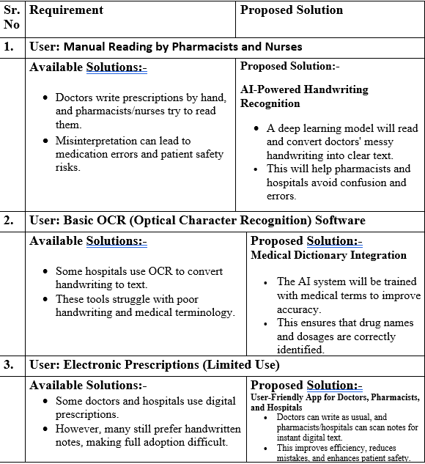
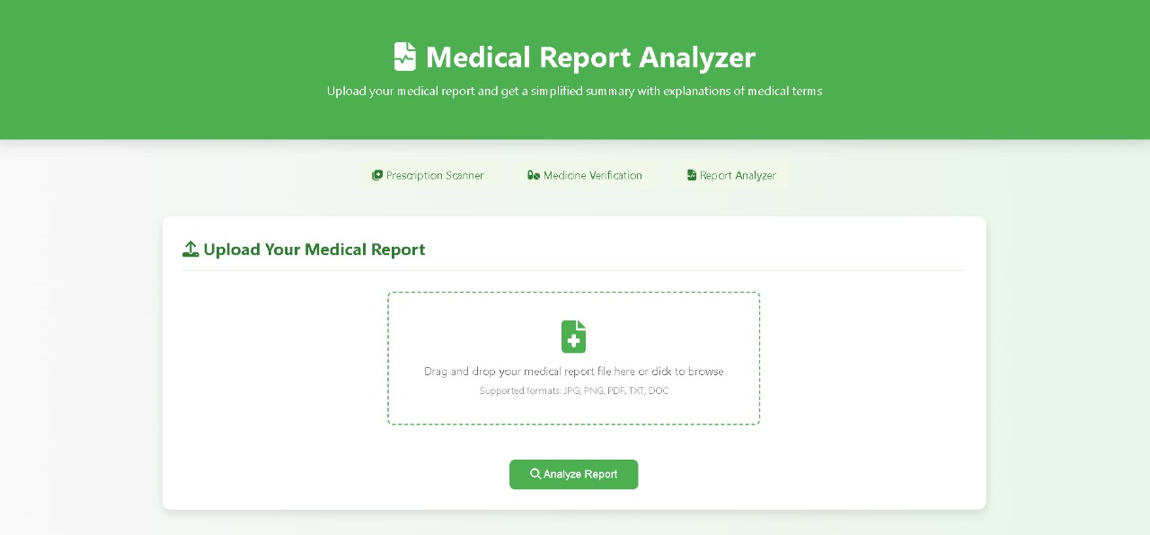
MIT SCHOOL OF COMPUTING
Class : TY AIA-3
Group Id: 304
DEPARTMENT OF COMPUTER SCIENCE & ENGINEERING
"Interpreting Doctors Note Using Handwriting Recongnition And Deep Learning Technique”
Tejas Raut, Shailaja Rautrao, Shruti Thorat, Om Talekar
Faculty Guide:
Dr. Sunita Parinam
What User Says : I can’t understand the doctor hand written prescription. I am not sure if I got the right medicine. I need to ask the doctor /pharmacist to confirm my dosage. I don’t want to take the wrong medicine by mistake. | What User Thinks: What if the pharmacist misreads my prescription and give me the wrong medicine? I wish there was an easy way to understand medical notes. If I lost this paper prescription, I won’t have any record of it. An AI tool to recognize doctors’ handwriting would make life easier.
What User Does: Struggle to understand their prescriptions. Ask doctors or pharmacists to clarify the medicine name or dosage. Sometimes rely on online searches to double-check their medication. Look up medication details to ensure they have the correct prescription. | What User Feels: Trusting that AI accurately converts prescriptions into readable text. Relieved if they receive a clear, digital prescription that’s easy to understand. That they no longer have to depend on pharmacists or family to read prescriptions. As digital prescriptions make refilling medicine faster and easier.
Proposed Architecture/ Diagram:
User
Problem Statement
Doctors often write prescriptions and notes in handwriting that is hard to read, which can lead to confusion and mistakes in patient care. This project aims to create an AI system that can read and understand doctors' handwriting using deep learning. By converting messy handwritten notes into clear, digital text, we can help pharmacists, nurses, and patients avoid misunderstandings, making healthcare safer and more efficient.
Proposed Solution
We will develop an AI system that understands doctors' handwritten notes using deep learning.:
This system will have multilanguage support.
It will also contain text to audio(speech recognition).
Medical abbreviation expansion and spell correction.
Drugs prescription validation and interaction checker
Scope and Feasibility
Scope: This project focuses on developing an AI system to recognize and convert doctors' handwritten notes into digital text. It can be used by hospitals, pharmacies, and clinics to reduce errors and improve patient safety. In the future, it can be expanded to support multiple languages, different handwriting styles.
Feasibility: The project is feasible with available deep learning techniques and OCR (Optical Character Recognition) tools. Training data can be collected from medical records.

